Slide 1
Investor Review
Last Updated 12.20.21

Slide 2
Problem
Schools focus on what to learn
—not on HOW humans learn:
—personal CURIOSITY
—the JOY of discovery
—owning MISTAKES
Investor Review
Last Updated 12.20.21
US world education rankings: Science 34th Math 28th
West Side SLC: 96% of 4th Graders cannot name the continent they inhabit
(US? Utah??)

Slide 3
Solution
Innovative ED Tech that:
—personalizes the learning experience through student interests
—leverages real-world relevancy across the curriculum
—provides real-time assessment of engagement and learning
—shifts learning ownership from the teacher to the student
Investor Review
Last Updated 12.20.21

Slide 4
Product
—WORLD’S BEST LEARNING APP??
ED Tech = Joyous Personalized Learning
—utilizes cutting-edge technology to
—target skills across the curriculum
—through real-world relevance and personal interest
Investor Review
Last Updated 12.20.21

Slide 5
Product
What is it?
—Open-source interactive mapping
—Students can travel across town or around the world
—A field trip every day
Investor Review
Last Updated 12.20.21

Slide 6
Product
What is it?
—Targets any subject using the real-world as the classroom
—Uses GIS, but not about GIS
—Designed for schools v Google Maps, Apple, Esri…
Investor Review
Last Updated 12.20.21

Slide 7
Product
What is it?
Key Innovations
—Automated lesson builder matches a student’s interests with subject & proficiency requirements
—Real-time assessment
—Engagement (# of clicks) —Proficiency (what is learned)
—Identify student learning styles (text, visual…)
Investor Review
Last Updated 12.20.21

Slide 8
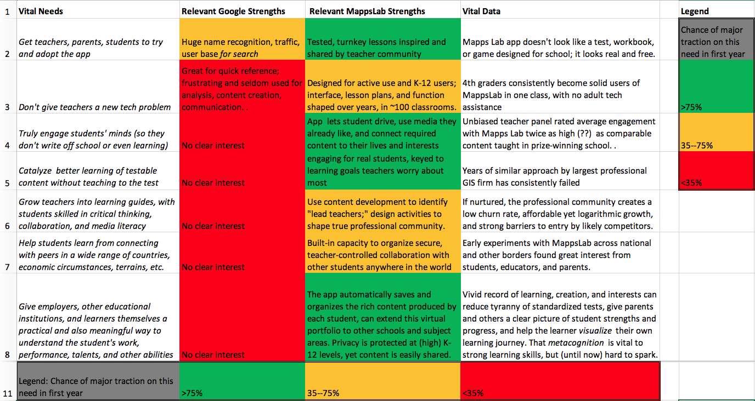
Product
V Google Maps (not relevant to k-12 classrooms—WE TRIED)
Investor Review
Last Updated 12.20.21

Slide 9
Product
Classroom Realities—teachers have NO TIME TO INNOVATE
—Web-based—zero prep or IT assistance needed
—Joyful = learning professional, not disciplinarian
—Metrics lead to mandatory use
Teacher moves from daycare specialist to Learning Professional
Investor Review
Last Updated 12.20.21

Slide 10
Product
Classroom Realities
—LESS work for teachers—more work for students
—app DESIGNED SPECIFICALLY for education
—admin, privacy, logistics
Investor Review
Last Updated 12.20.21

Slide 11
Underlying Magic
Using 21st Century interactive mapping
—bringing the real world into the classroom
Students become active tech creators v passive consumers
Critical Web Users
—first steps toward solving the “Facebook Problem”
This is a paradigm shift for 21st Century formal learning
—reframing the narrative to student-owned learning experiences
We need smart humans now!
Investor Review
Last Updated 12.20.21

Slide 12
The Team—Teamball
Risking turnovers—making assists
Micro-macro
—from 3rd grade classrooms to keynoting the NEA
Commitment to better world.
Broad range of skills—from ND to RAND to MIT to the playground
—educators
—community builders
—education sales (Apple ED Sales Director…) —created largest teacher training in US history (28% of k-12)
Investor Review
Last Updated 12.20.21

Slide 13
Traction/Milestones
—30 years in education
—Interactive mapping replaces media (cameras) as personal creative empowerment
—students use internet v passive consumer
—teacher friendly—turnkey—frees up time
2010—ESRI—intro to interactive mapping (UDOT Grant)
2015—MappsLab app prototype proves joyous, not scalable
2022—app built to scale without any teacher prep
Spring 2022—Need rigorous classroom metrics/creative development
Investor Review
Last Updated 12.20.21

Slide 14
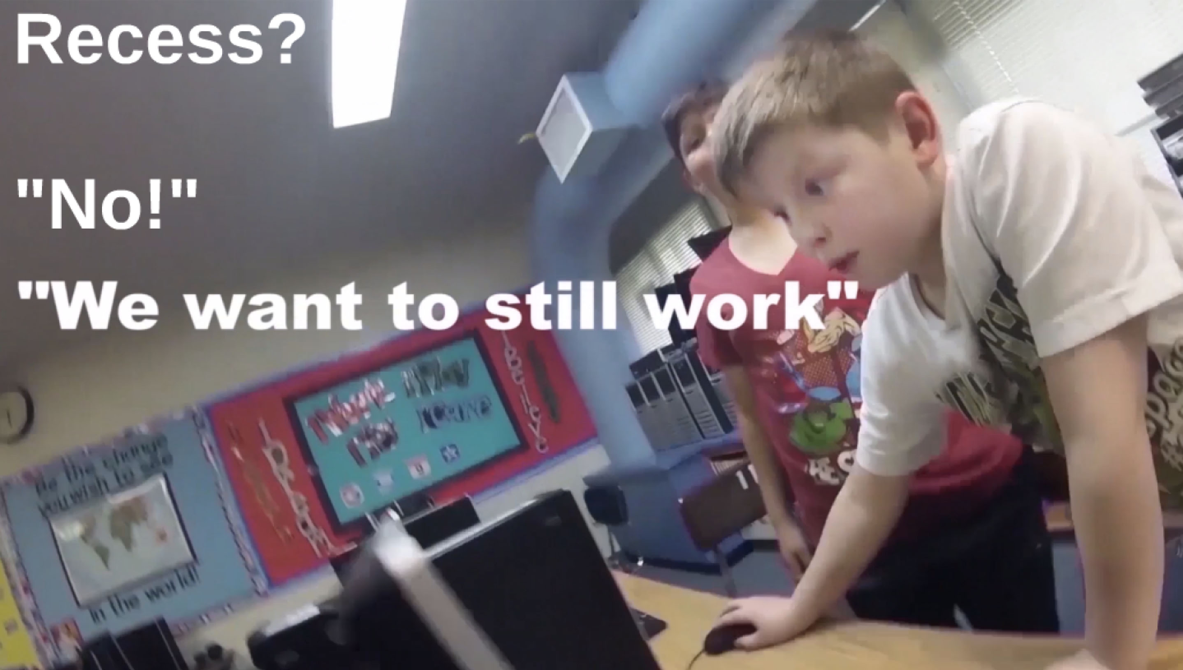
TESTIMONIALS————BETTER THAN RECESS
Investor Review
Last Updated 12.20.21

Slide 15
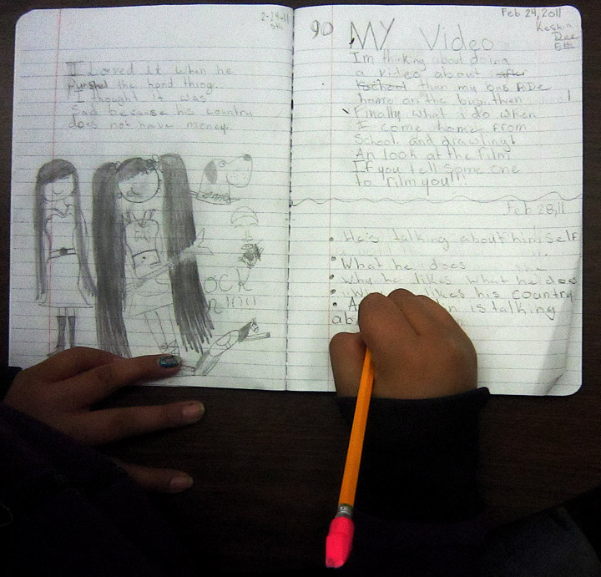
————WRITING WITHIN 30 SECONDS
Investor Review
Last Updated 12.20.21

Slide 16
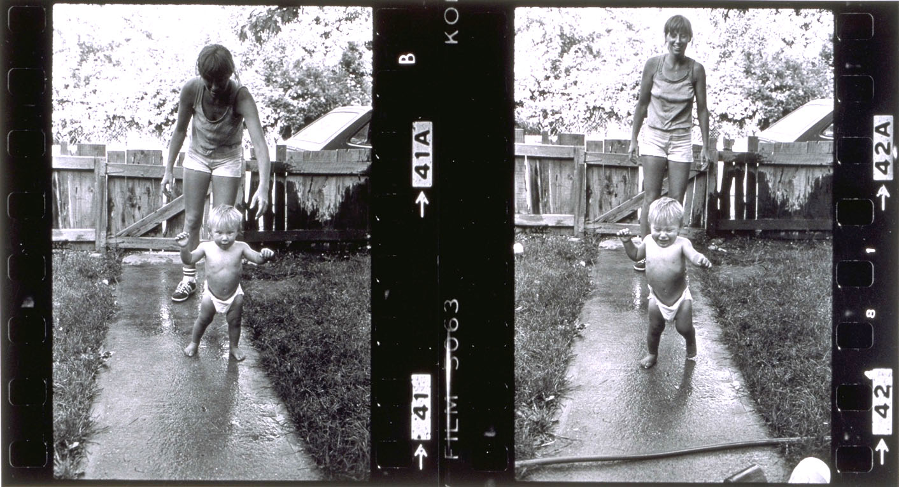
————THE GOLDEN CHILD—Joyous Learning
How Humans Learn Best
Investor Review
Last Updated 12.20.21
—The NEW/OLD Paradigm For Schools

